Slide 1
Gaming-Bets
An E-Sport App!
By André Helbig, Felix Morsbach
If E-Sport was easy, it would be called Soccer!

Slide 2
Agenda
Vision
Use Cases
Project Team
Project Management
Technical Architecture
Database
Behavior Driven Development

Slide 3

Vision & Scope!
We strive to be the best!!!
We love E-Sports!
We want to win!!

Slide 4
Open for MORE!

Slide 5
Technical Architecture
Repository Pattern (Java Persistence)
http Call
Client
Server
Database
Answer
Notes:
Easy to Replace Communication Typ!
Frameworks?

Slide 6
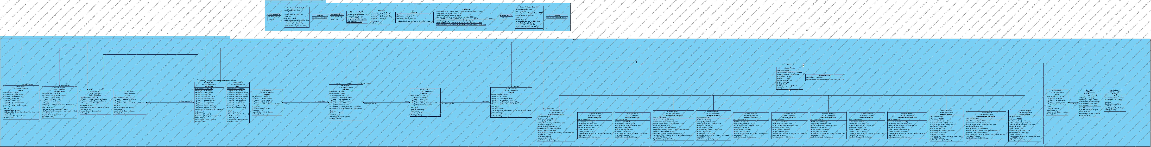
Class Diagram Sever

Slide 7
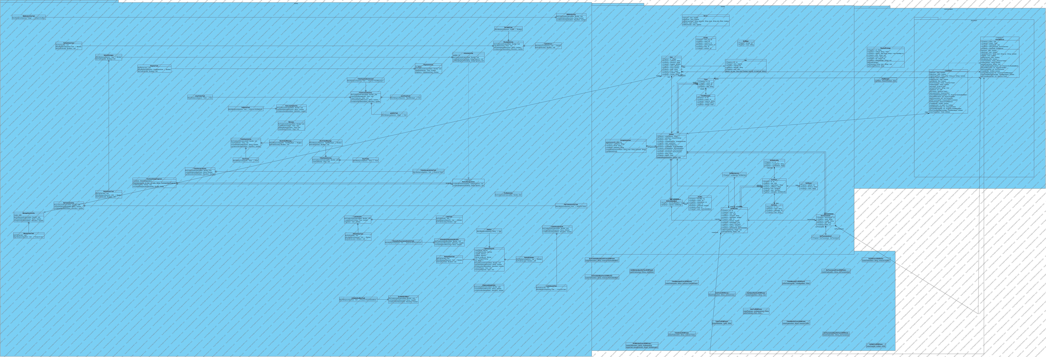
Class Diagram Client

Slide 8
Demo
lets gooo?
Notes:
Link updated?

Slide 9
Project Team
Felix Morsbach: Project Manager, Test Manager, Implementer, Desinger
André Helbig: Integrator, Software Architect, Tester, Designer

Slide 10

Project Management
Jira as preferred platform
Optimal for Agile Developement
Statistics and Diagrams like a Burndown Chart
Iterative Process
Ready for YOUR Wishes!
Notes:
For short term Planning
Integrated jira into IDE (at least at some point in the past)
Automatically loging worktime
WHY RUP? WHY SCRUM?
Integrate Change requests in workflow
Client sees the product on a regular basis, not just 2 weeks before release

Slide 11
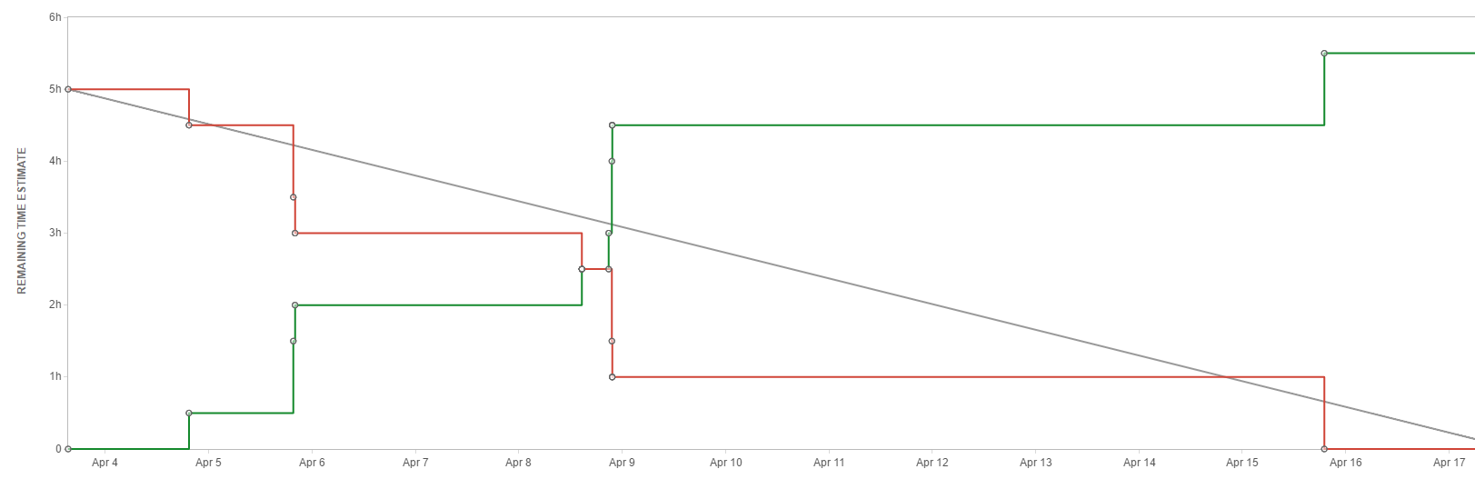
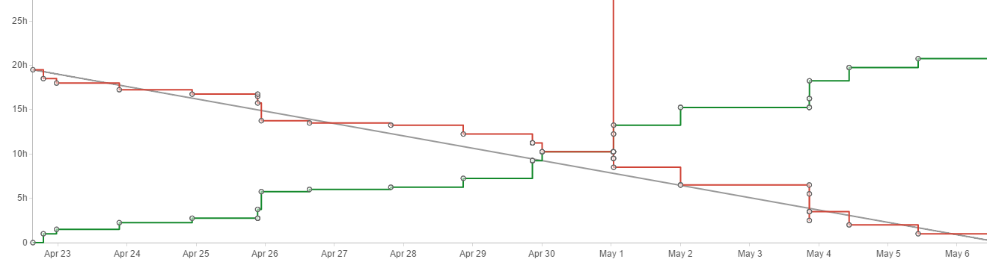
Project Management
Jira as preferred platform
Optimal for Agile Developement
Statistics and Diagrams like a Burndown Chart
Iterative Process
Ready for YOUR Wishes!
Notes:
Integrated jira into DIE
Automatically loging worktime

Slide 12
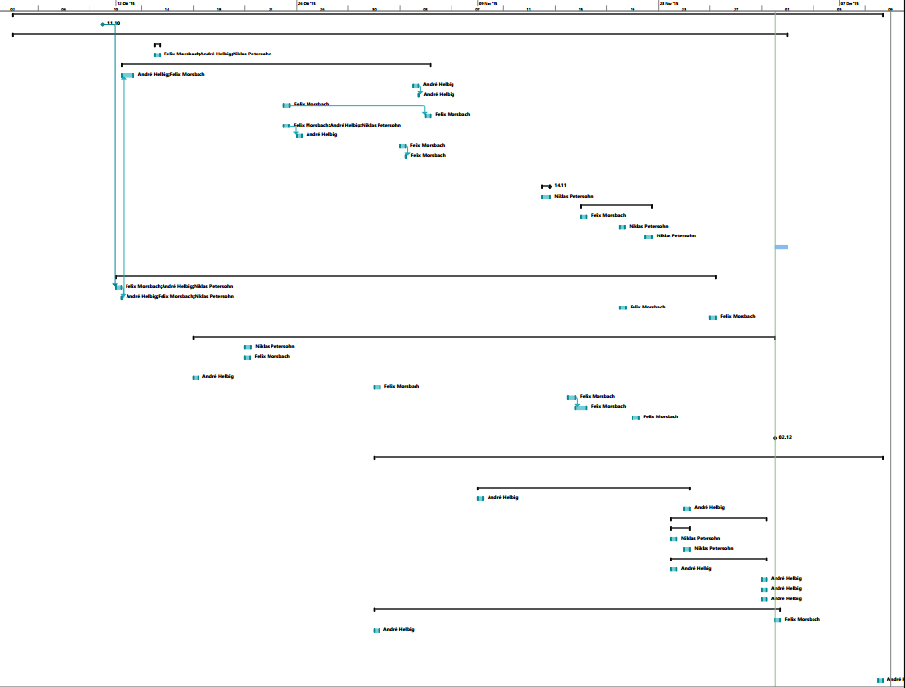
Gantt Chart
Logged worklog according to Issue/Subject
Results in a Gantt Chart of past activities

Slide 13
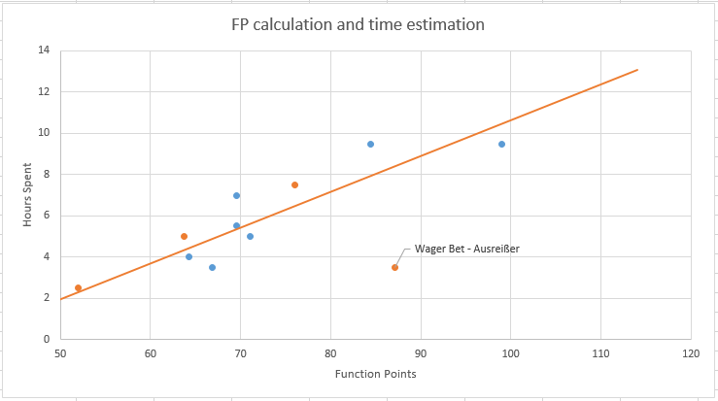
Check Game Results: 51,92 FP → 2,28h
Bet on Win: 76,5 FP → 6,47h
Wager Bet: 87,1 FP → 8,39h
Buy Reward: 63,7 FP → 4,32h
Notes:
Outlier / spike because of code reusage
At lot/Most work went to server sided logic and configuration, aswell as data base modelling

Slide 14
Gantt Chart - Estimation

Slide 15
Risk Management

Slide 16
Life Cylce Management
Versioncontrol with GitHub
IDE integration
Automated Build with each GitHub Push
Automated Test with every Build
Static Code Analysis and code coverage reports with every build
Automated deploy after succesful build to application server
Notes:
Badges on github as representation of actual status, can be embedded to other platforms aswell

Slide 17
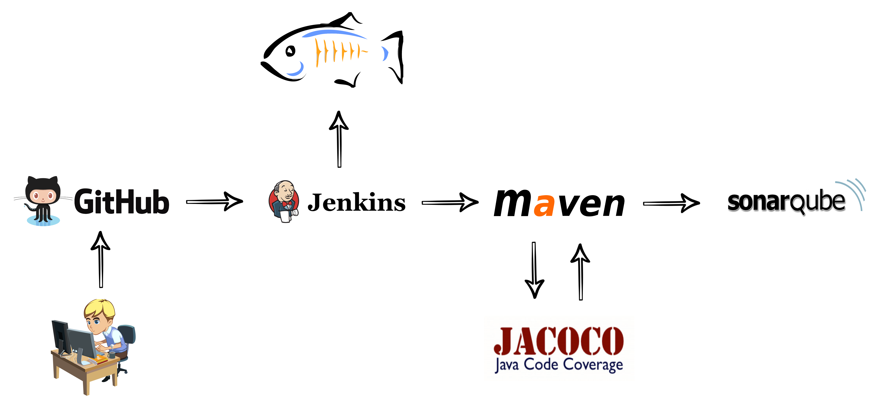

Slide 18
Behavior Driven Developement
Tests written in Gherkin
Easy to Use for non Programmers
Use predefined Steps!
Calabash for Android Testing
Reports

Slide 19
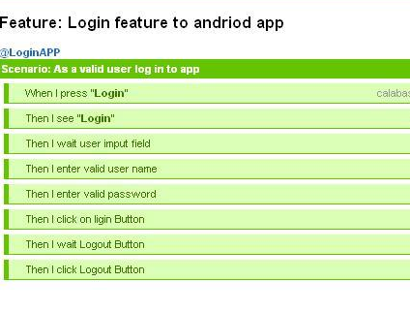
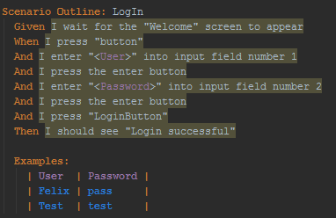
.feature File
Calabash
Report

